Slide 1
Apriori Algorithm project by Group 8

Slide 2
Agenda
Introduction
Project phases
System architecture
Pseudocode
Output sample

Slide 3
Introduction
Apriori is an algorithm used to find the relation between items or categories.
This has applications in domains such as market basket analysis.
Apriori uses a "bottom up" approach, where frequent subsets are extended one item at a time.
The Apriori algorithm was proposed by Agrawal and Srikant in 1994.

Slide 4


Slide 5
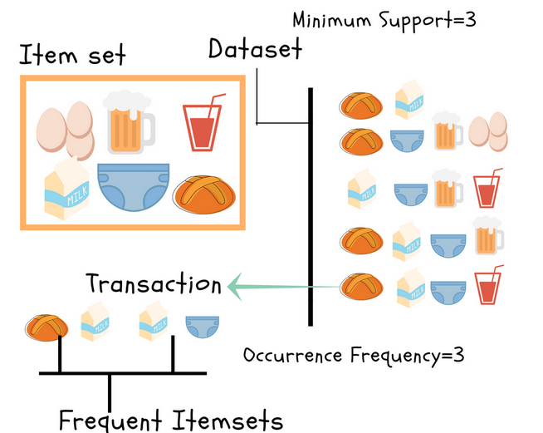

Slide 6
Project phases
Phase 1: Design the schedule for the project.
Phase 2: Divide the code into separate functions.
Phase 3: Start implementation.
Phase 4: Integrate the code.
Phase 5: Test the code.

Slide 7
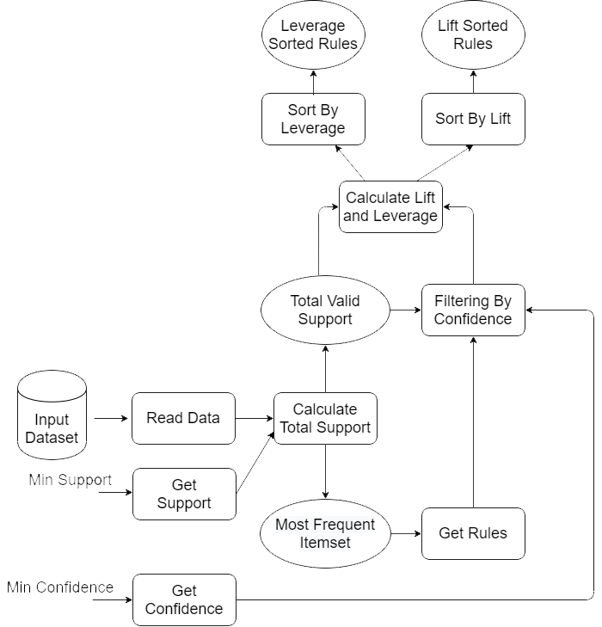
System architecture

Slide 8
Pseudocode
Get minimum support
Get minimum confidence
Calculate total valid support
Get association rules from the most frequent item set
Filter the association rules with the minimum confidence
Calculate the lift and leverage
Sort the rules with Lift
Sort the rules with Leverage

Slide 9
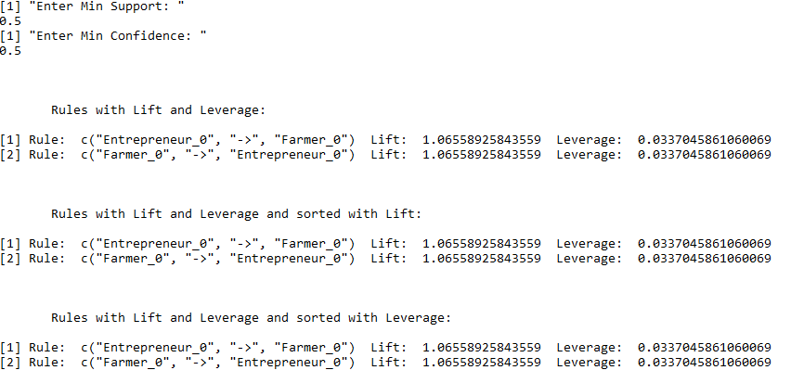
Output sample

Slide 10
Thank you

